Slide 1
Diaspora and Transnationalism: An Introduction
Instructor: Dr Ratna Bharati B
Course Code: HM 494

Slide 2
The Kangany System in the Plantations of South India : A Study in the Colonial Mode of Production
Article name: The Kangany System in the Plantations of South India : A Study in the Colonial Mode of Production
Author(s): S.Suresh Kumar
Source: Proceedings of the Indian History Congress, 1988, Vol. 49 (1988), pp. 516-519
Published by: Indian History Congress
Stable URL: https://www.jstor.org/stable/44148440

Slide 3
Objective of the paper
1.1 study the linkages between colonialism and modes of production and its influence upon the economy and society in general, especially in determining the nature of capitalism
The hypothesis is whether the colonial mode of production can be treated as a distinct and discrete social formation or a mere transitional process in the emergence of a capitalist mode of production

Slide 4
Who were Kanganis?
1.1 The Kangani system that prevailed in the plantations of South India prior to independence. The Kanganies were the principal agents of recruitment of labour for plantations in South India, the other agents of recruitment of labour being the estate gangs.
the areas most suited for tea cultivation were covered with thick unhealthy forests which had to be cleared
Secondly, most suitable places for the establishment of plantations were in areas where labour supply was sparse.

Slide 5
Why the Kangani System?
A high wage rate who have brought more workers but planters were unwilling to pay
Hence the Kangani system; There were also rubber plantations
Sheer numbers reduced the wages of plantation labour to a minimum, and the social ties and obligations established by Kangani recruitment helped keep the coolies working obediently on the one plantation for long periods
Frequent failure of the monsoon resulted in drought and famine; the system of taxation the British Raj imposed exacerbated poverty and indebtedness. The people most affected were Untouchables and of the lowest castes. Recruitment for employment in Malaya was often an alternative to starvation, both for themselves and the families they left behind.

Slide 6
Why the Kangani System?
1.3 A special feature of the plantations was that it required a large resident labour force consisting of men, women and children.
The initial attempts to hire the locals, particularly tribais, by the pioneer planters ended in a dismal failure
Some of the recruits died in transit and in the estates, other fled away
These conditions might have compelled the Englishmen to think in terms of something like the Zamindari System which was successful
https://core.ac.uk/download/pdf/36988015.pdf

Slide 7
Why the Kangani System?
1.3 The result was the Free Contractors System
In the Assam tea plantations these contractors were known as Sardars/Sirdars
A variant of the Sardari System obtained in South Indian Plantations was the Kangany System
The Kanganies like their counterparts in the food crops production, the Zamindars, formed the chief instruments of British Colonialism
The ingenuity of the colonists found its full play in the evolution of the Kangany System on the patterns of the Zamindari

Slide 8
Why the Kangani System?
What is the Zamindari System? Video
https://www.youtube.com/watch?v=gaPRbNiLufQ&t=157s
1.3 Kanganies were drawn from the ranks of the estate labourers themselves, unlike the Zamindars.But later the position became heritable and thus Kanganies belonged to the same or related families. In an estate at Ponmudi in Trivandrum (Kerala) the members of a family from Tirunelveli (TN) were the Kanganies for generations till it was abolished in 1956

Slide 9
Remuneration
1.4 The Kangany usually received remuneration at the rate of 10-15% on the checkroll earnings of the labourers supplied
The higher commission was given for increased attendance of the workers, or if the Kangany had received no advances to be given to workers or if he had brought at least 80% of the workers he had agreed to.
Besides, the Kanganies received remuneration proportionate to the amount of work done by their labourers
The Kanganies were given the freedom to dictate the terms of settlement with the labourers recruited by them and under one pretext of other the Kanganies withheld the payments to the labourers.

Slide 10
Remuneration
1.4 In South India, a plantation labourer belonged more to the Sardar of Kangany than to the estate.
The annual settlement was just in paper. In effect, the labourer was condemned to stay there till his death
The Kanganies usually took up contract work from the managers especially for weeding and in order to make better profits employed women and children on the work and extracted more labour from them.
The settlement of wages was affected through the Kanganies they would retain the whole amount under one pretext or other.

Slide 11
Role of Government
Government supported Kangani/y System instead of intervening
The then Travancore Government lavished funds for the creation of infrastructural facilities in plantation
British govt came up with Act: Workmen's Breach of Central Act of 1859: intended to prevent the captive labourers from fleeing from the plantation
It specifically provided the plantations with the power to prosecute defaulting coolies

Slide 12
Role of Government
State/Govt supported capitalists in perpetuating this tyranny can be understood from the reply given by UPASI- (United Planters Association of South India) questionnaire prepared by the Labour Investigation Committee of the Government of India in 1945
"No Law has been passed to prohibit the employment of children under ten on plantations … No Special Machinery set up in South India to safeguard the interests of workers in repatriation do not maintain any service or regard to recruitment or repatriation.. There are no wage Boards for planting industry… Retirement is usually the result of infirmity arising from old age

Slide 13
Kangani System - Terms of Contract
Even though some estates did had a written agreement with the Kagani stipulating that the labourers supplied would work for 10 months there was no legal contract entered
This prevented any formal relationship between the planter and labourer
This resulted in a hierarchical relationship which gave a feudal outlook
A chief feature of the Kangany recruited labour force in Travancore was that around 80% of the labour came from the neighbouring Tamil Districts of Madurai and Tirunelveli, one of the major recruiting centres for plantation.
Cheaper labour than Kerala

Slide 14
Why recruit labourers from elsewhere?
a Breman noted "outsiders were far easier to bring and keep under control. Labourers coming from elsewhere are often not familiar with the local customs and language. The are defenceless in the face of the power exercised over them. This vulnerability is exacerbated by a system of diversified recruitment among the migrant population". The recruitment of indentured labour from outside the region was thus due to colonial compulsions and a miniature of it is obtained in the plantations of Travancore.

Slide 15
What are the features of Kangani/y System
These features of the Kangany System defy an easy categorisation in terms of
capitalism or feudalism. The type of economic organization obtained in plantations
had most of the features of the capitalist system: (1) private ownership and control
of the economic instruments of production i.e. capital, (2) the gearing of economic
activity for making profits, (3) a market framework that regulated this activity and
(4) the appropriation of profits by the owners of the capital. In a capitalist system
the labour is by workers who are free agents, but here we geta lord-serf relationship.

Slide 16
When was Kangany System Abolished?
India became independent, the Government passed many laws protecting the plantation workers and provided them with a degree of security, the most important of which was the Plantation Labour Act of 1951. The Kangany System itself was abolished in 1956. The Kanganies became supervisors. It was nòt merely a change in nomenclature but a change which had far-reaching implications. The service conditions of the supervisors and labourers were regulated and their relationships were defined in concrete legal terms. Most of the vestiges of the old feudal pattern vanished as a consequence

Slide 17
Tamilians in Malaysia
The Kangani system was of labour recruitment was community based. Most people had close relationships with their kin in Tamil Nadu
No Brahmin migrated to Plantations. Other caste divisions include: non- brahmin and Adi Dravida
Further divided into castes and jatis: imp for socially placing the progenys
Article: Indian Diaspora, Old and New: Culture, Class and Mobility
Author(s): Ravindra K. Jain

Slide 18
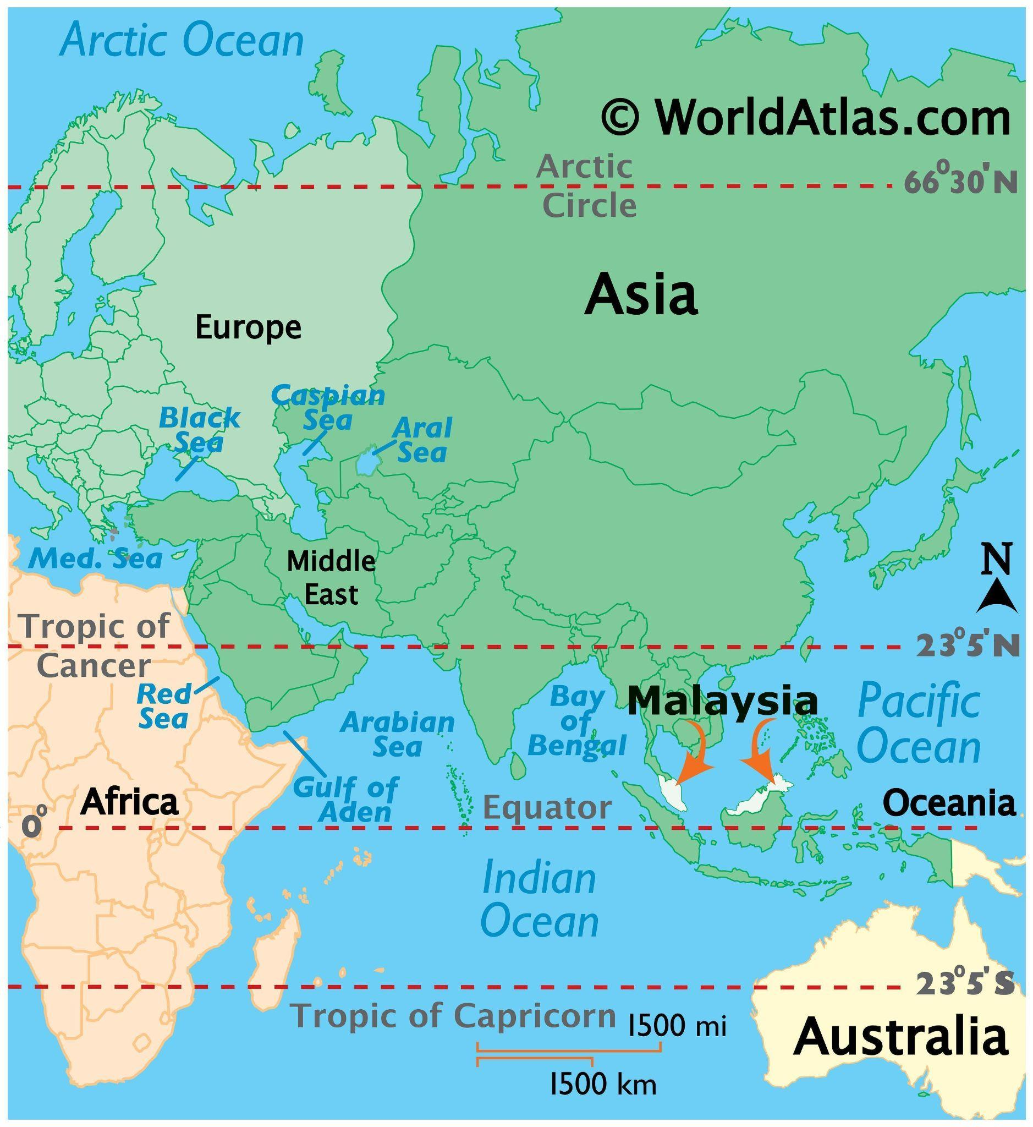

Slide 19
Identity formation
However, the predominant form of social stratification on based on caste or jati but on the community-cum-industrial subsystems of the locale. Currents of cultural nationalism were derived from Tamil Nadu. In the mid 20th century the Dravidian movement entered this system of the workers' proletarian identity with the strong anti-Brahmanical appeal among estate workers. This was a perfect example of "nationalism without nation” and of "long-distance nationalism"
What is the Dravidian Movement? Homework
There was identity crisis among the immigrant youth born and brought up in plural and multicultural society of their parents' adoption

Slide 20
Dravidian Movement (diff reading)
The practical policy of the Dravidian movement is to 'de-Sanskritize' and 'de-Brahmanize' South Indian culture and society by restoring the original Dravidian civilization. This restoration program has included attempts to remove Sanskrit, Hindi and other 'foreign' elements from Tamil language and literature, smashing of idols and images, simplifying rites and ceremonies by not using Brahman priests and rituals, reinterpreting the Ramayana, the Puranas, and the Vedas to reveal the 'oppression' and 'calumny' of the Dravidians, and attacks on Brahmans and the 'superstitious' beliefs and practices of Sanskritic Hinduism

Slide 21
Dravidian Movement (diff reading)
On the social side, the movement has advocated later age of marriage and widow remarriage; a quota system for Brahmans in education, government administration rejection of the varna classification, and the use of Tamil as the medium of instruction in schools and universities.
The significance of the Dravidian movement lies rather in its use of such studies and of the modern techniques of propaganda and political organization to propagate a cultural ideology and model of a Dravidian Great Tradition, and to make it the cultural basis for a successful political party, the Dravidian Progressive Federation, D.M.K., which is now in
power in Tamilnadu.

Slide 22
Caste
Since the dismantling of rubber plantations and the to their own small holdings and to urban areas, the Great Traditions Gods like Subramaniam are worshipped largely without the saiva siddhantam associated with them.
Adi- Dravida castes: monopolies of cleaning and scavenging
in Malaysia, in Batang Berjuntai the cinema hall and bus-service are owned by members of Adi- Dravida Caste
even on the Estates, the differences between the higher (non-Brahmin) and lower caste (Adi-Dravida) reduced
On collective festive occasions, Adi - Tiruvela a feast in the temple premises was organized and everyone sat together

Slide 23
Caste System
There was a caste war going on. No Brahmins. Only between Non-Brahmins and Adi-Dravidas
The Vanniar as "dominant caste" and Adi Dravidas as the "subordinate castes"
That caste was increasingly an aspect of culture rather than of social stratification per se was broadly true of the isolated and insulated circumstances of estate living.
Adi-Dravidas Sanksritized - MN Srinivas - Sanskritization process - entered Tamilian ritual life

Slide 24
Caste System
Thandayudapani temple in Batang Berjuntai epitomizes that process
Non- brahmins focused on entrepreneurship, Adi-Dravidias - cultural entrepreneurship
become managers of the ritualistic and social (e.g. marriage functions of the new temple, on the other hand, teachers of their castes- educated ones like Rajagopal - have undertaken in a manipulative and entrepreneurial way to motivate the youth (especially children) of their own caste but with focus on individual mobility, popularity and leadership
This ideology is called Dravidian Tamil Ideology

Slide 25
Caste system
Muniandy, temple chairman, discusses the Vanniars as Telugu refugees (rather than claimed rulers) in Tamil Nadu. The titles Reddi, Naicker, Naidu etc from the Telugu country. The real Tamilians are Adi Dravidians
Inter caste marriages happened but were looked down upon
Sondakarar - those who intermarry among castes
Endogamy and Kinship is strong
Ganesan - catering business - only for Non Brahmins
Roti-Beti ka Rishta MN Srinivas - Homework

